Slide 1

Hima Sri Chunchu
24-10-2024

Slide 2
Outline
Executive Summary
Introduction
Methodology
Results
Conclusion
Appendix

Slide 3
Executive Summary
To develop a predictive model to determine the success of Falcon 9 first-stage landings.
Understanding landing success can drastically reduce launch costs and enhance competitiveness.

Slide 4
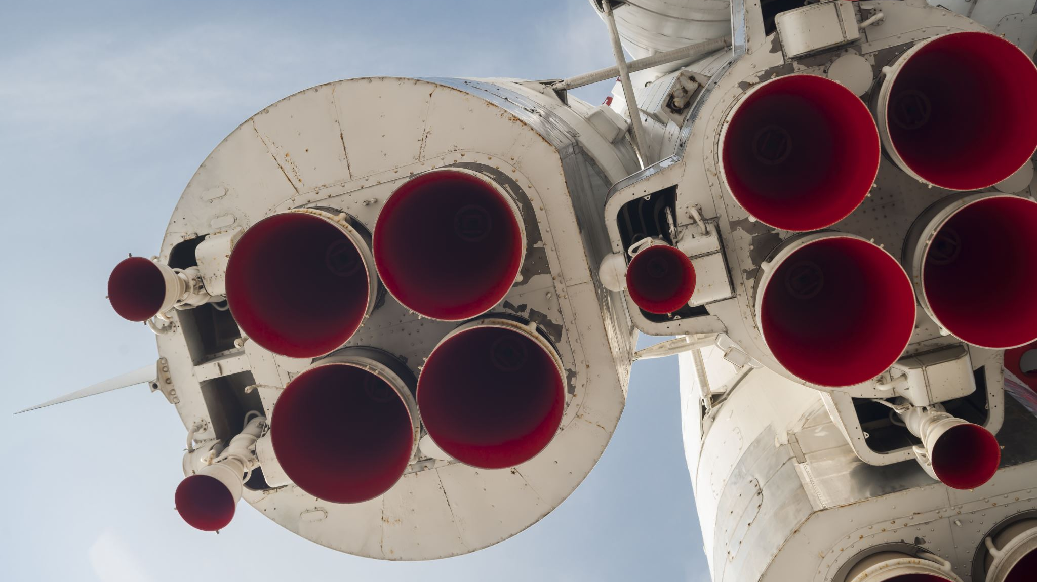
Introduction
Space X pioneered the use of reusable rocket technology, significantly altering the landscape of the aerospace industry.
The Falcon 9 is a two-stage rocket designed and manufactured by SpaceX for the reliable and safe transport of satellites and the Dragon spacecraft.
It is notable feature is the first-stage landing capability, allowing the first stage to return to Earth and land vertically, making it reusable.
SpaceX charges approximately $62 million per launch, substantially lower than competitors like Arianespace and United Launch Alliance, which can charge upwards of $165 million.
The significant cost reduction is primarily due to the ability to reuse the first stage of the Falcon 9.

Slide 5

Methodology

Slide 6
Data Collection
Request Falcon9 Launch Wiki Page from its URL (Use BeautifulSoup)
Extract all column/Variable names from the HTML Table Header
Create a Data frame by parsing the HTML table
Convert to csv file and store

Slide 7

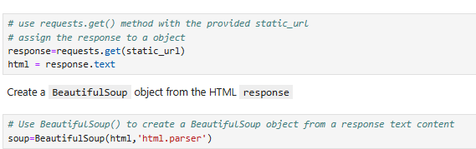
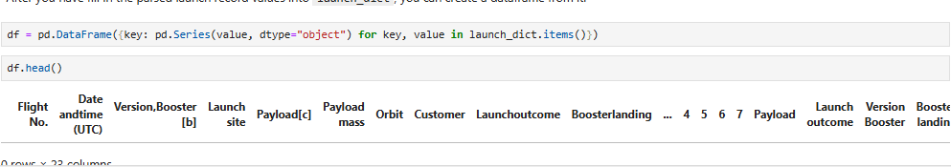
Data Collection – SpaceX (Web Scraping)
Github: spacex/spacex/Sapcex-webscraping.ipynb at main · Hima0456/spacex

Slide 8

Data Wrangling
GitHub: spacex/spacex/spacex-Data wrangling.ipynb at main · Hima0456/spacex
Convert
Convert to DataFrame
Handle
Handle Missing Values
Validate
Validate Data Types
Analyze
Analyze Launch Data
Classify
Classify Outcomes
Calculate
Calculate Success Rate

Slide 9

Launch Sites Analysis with Folium
Using Folium, we analyzed SpaceX launch sites to explore how location factors might impact success rates. Key tasks included:
Mapping Launch Sites: Plotted all SpaceX launch sites to visualize site locations geographically.
Success/Failure Markers: Indicated launch outcomes at each site to observe any patterns in success rates.
Proximity Calculations: Measured distances from launch sites to nearby landmarks to assess any spatial influences on launch success.
spacex/spacex/SapaceX DataVis Folium 4.ipynb at main · Hima0456/spacex

Slide 10
EDA with SQL
The analysis highlights SpaceX's operational patterns, such as preferred launch sites and booster payload capabilities.
Ranking landing outcomes helps understand the progress in achieving reliable landings, a key goal for cost reduction.
Identifying the first successful ground landing is a milestone that marks a breakthrough in reusability.

Slide 11

EDA with Visualisation
This analysis explores factors influencing SpaceX landing outcomes, focusing on visualizing patterns and engineering features to enhance prediction accuracy. Key insights reveal that most unsuccessful landings are planned ocean landings, as SpaceX often opts for controlled ocean landings for specific missions.
Objectives
Exploratory Data Analysis (EDA): Use Pandas and Matplotlib to visualize data patterns, focusing on landing outcomes and associated factors.
Feature Engineering: Prepare data to extract new features, helping to identify trends in landing success rates.
spacex/spacex/SapceX-eda-dataviz-v2.ipynb at main · Hima0456/spacex

Slide 12
Build a Dashboard with Plotly Dash
Visuals & Interactions:
Pie Chart: Shows launch success rates by site. Allows users to compare success rates across all sites or focus on a specific site.
Scatter Plot: Displays the relationship between payload mass and launch outcome, with filters for launch site and payload range.
Key Features:
Dropdown Filter: Select specific launch sites to analyze success rates individually.
Range Slider: Adjust payload mass range to examine its effect on launch outcomes.

Slide 13
Predictive Analysis (Classification)
Data Preprocessing:
Standardized features using `StandardScaler`.
Model Training:
Split data into training (80%) and testing (20%) sets.
Used multiple models: Logistic Regression, SVM, and Decision Trees.
Hyperparameter Tuning:
Employed `GridSearchCV` to optimize model parameters for Logistic Regression, SVM, and Decision Trees.
Model Evaluation:
Evaluated models using accuracy scores and confusion matrix.
Best Logistic Regression model achieved an accuracy of 83% on the test data.
Best SVM model achieved an accuracy of 67% on the test data.

Slide 14
Insights Drawn from EDA

Slide 15
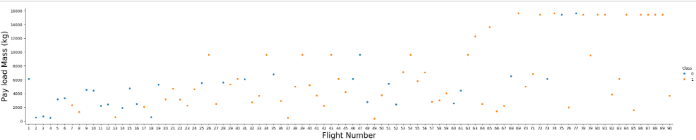
Flight Number vs. Launch Site
This graph demonstrates that over time, the vehicles carrying higher payload masses have increased significantly. Additionally, the success rates of launches have also improved, suggesting advancements in mission capabilities and vehicle reliability.

Slide 16
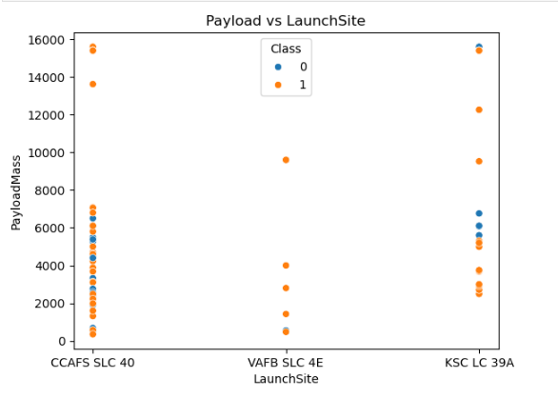
Payload vs. Launch Site
‘VAFB SLC’ site used for fewer launches and payload load no more than 10000 kg.
‘CCAFS SLC’ is mostly used for lesser payload mass gradually increasing the mass.

Slide 17
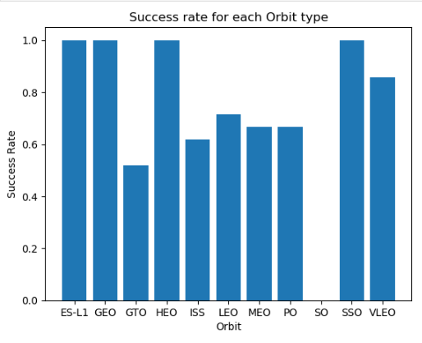

Success Rate vs. Orbit Type
Orbits such as ES-L1, GEO, HEO, and SSO show consistently higher launch success rates compared to other orbits. These orbits have a more reliable track record for successful launches.
The SO orbit stands out with a significantly lower success rate, indicating potential challenges or anomalies in launches to this specific orbit.

Slide 18
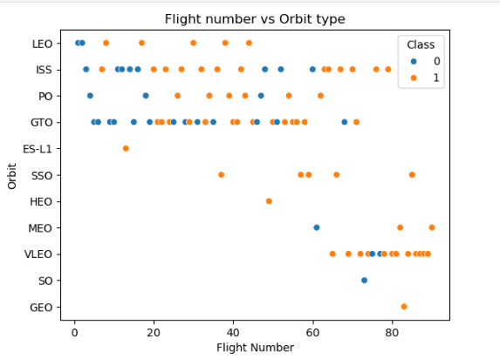
Flight Number vs. Orbit Type
Success rates in LEO show a positive correlation with Flight Number, suggesting improved outcomes with more experience.
No correlation between Flight Number and success rates in GTO, implying that other factors may influence success here.
Most launches target ISS, GTO, and later VLEO orbits, indicating these as priority destinations.
VLEO (Very Low Earth Orbit) has recently become a popular destination with relatively high success rates, highlighting it as a promising target for future missions.

Slide 19
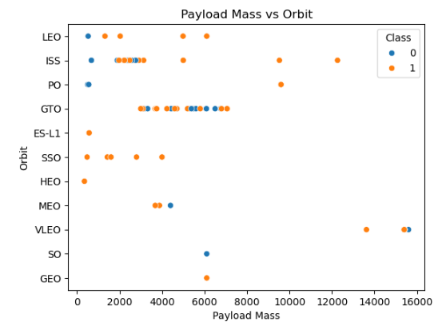
Payload vs. Orbit Type
For heavy payloads the successful landing rate is more for Polar, LEO and ISS.
However, in GTO it has more positive and negative outcomes

Slide 20
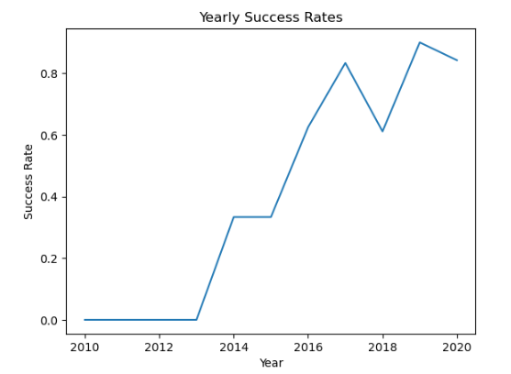
Launch Success Yearly Trend
The analysis reveals an upward trend in the average success rate beginning in 2013, reaching its highest point in 2019, where the success rate surpassed 85%. This trend suggests steady improvements over time, with 2019 standing out as a peak year for successful outcomes.

Slide 21
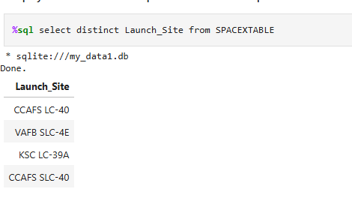
All Launch Site Names
There are 4 distinct launch site available

Slide 22
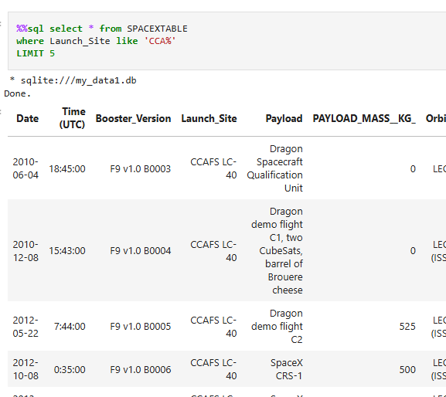
Launch Site Names Begin with 'CCA'
These are the records of launches that happened at CCA sites

Slide 23
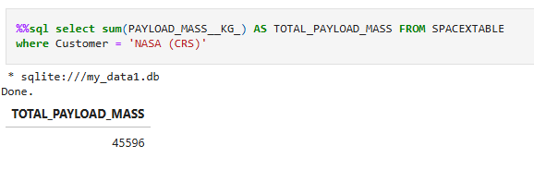
Total Payload Mass
This is total payload mass carried by boosters launched by NASA (CRS)

Slide 24
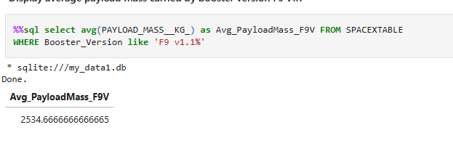
Average Payload Mass by F9 v1.1
Average payload mass carried by booster F9 v1.1

Slide 25
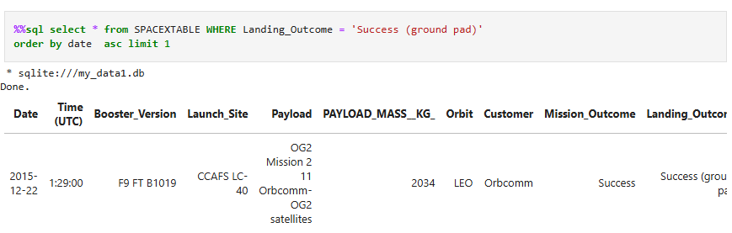
First Successful Ground Landing Date

Slide 26
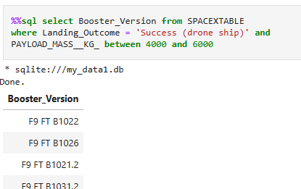
Successful Drone Ship Landing with Payload between 4000 and 6000
The Booster that made successful landing with Payload mass between 4000 and 6000 kgs.

Slide 27
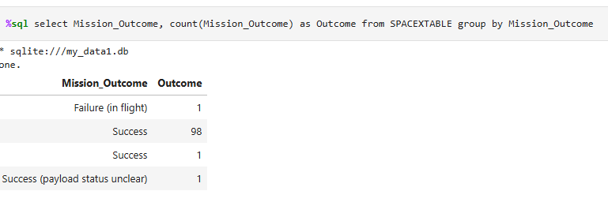
Total Number of Successful and Failure Mission Outcomes

Slide 28
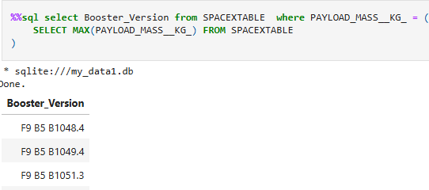
Boosters Carried Maximum Payload

Slide 29
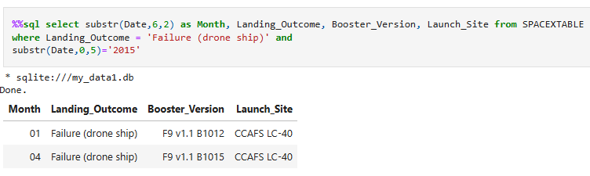
2015 Launch Records
Failed (drone ship) outcomes in 2015

Slide 30
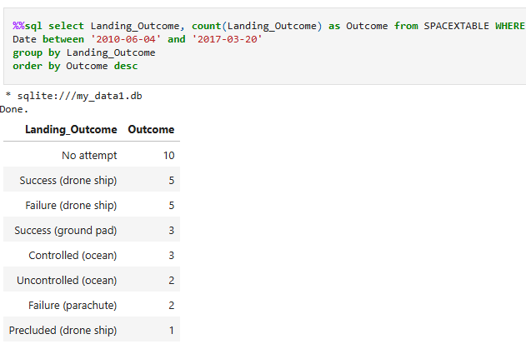
Rank Landing Outcomes Between 2010-06-04 and 2017-03-20

Slide 31
Launch Sites Proximity Analysis

Slide 32
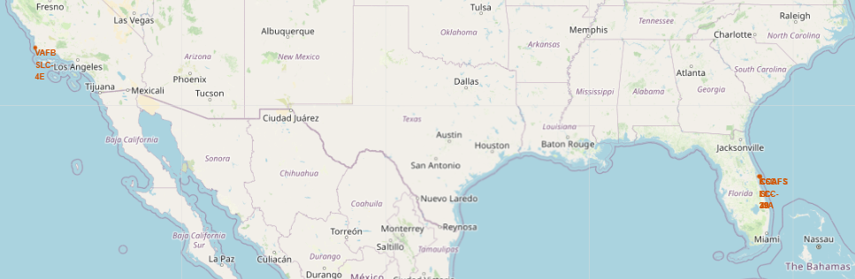
Different Launch Sites

Slide 33
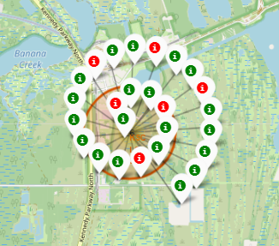
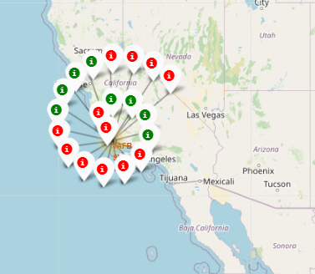
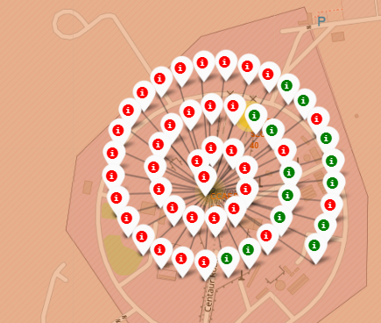
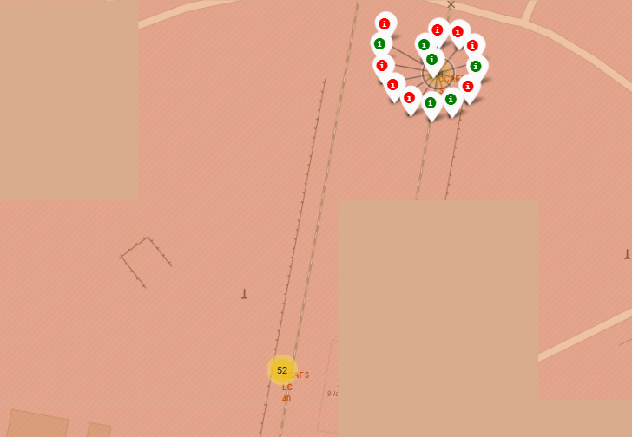
Outcomes at different Launch Sites

Slide 34
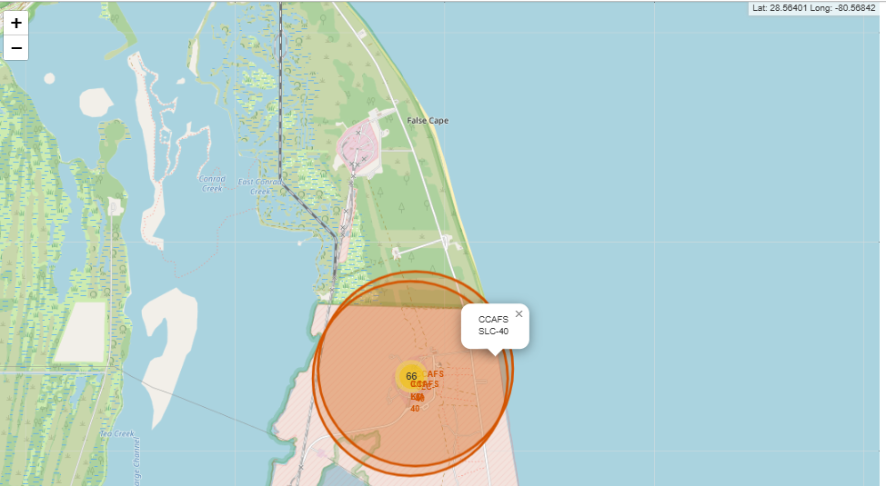
Launch Site Proximities
Zoomed into each launch site to examine proximity to key infrastructure (railways, highways, coastlines, etc.) and noted coordinates for distance calculations from the launch site.

Slide 35
Build a Dashboard with Plotly dash

Slide 36
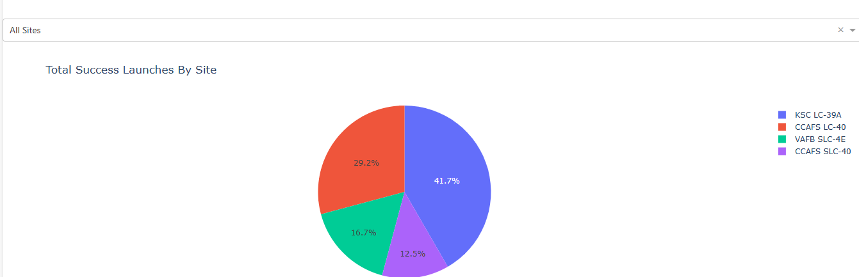
Success Rates for all Launch Sites
The pie chart visualizes the success rates for each launch site, with the ability to filter for more detailed success percentages at individual sites.

Slide 37
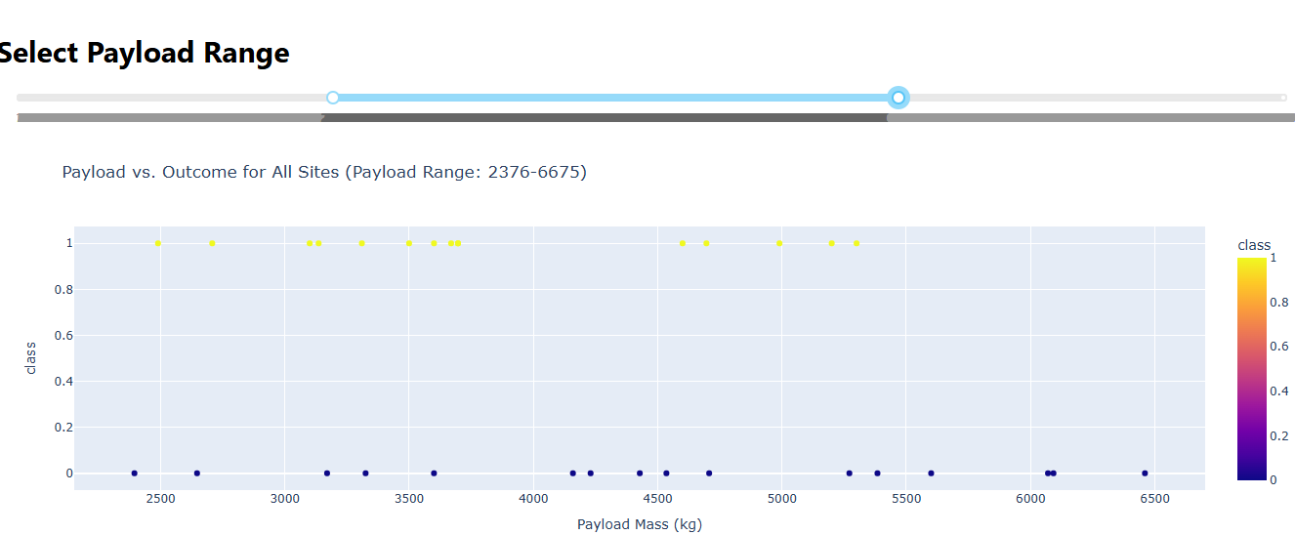
Payload mass vs Landing Outcome
The scatter plot illustrates the variation in payload mass and landing outcomes. Adjusting the range allows for a clearer view of this variation.

Slide 38
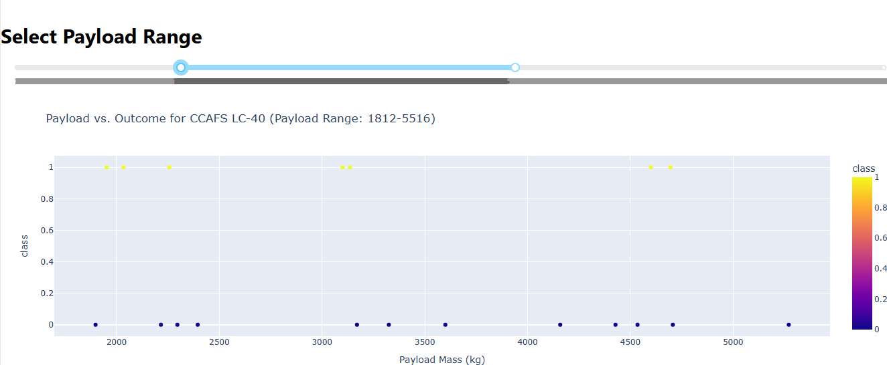
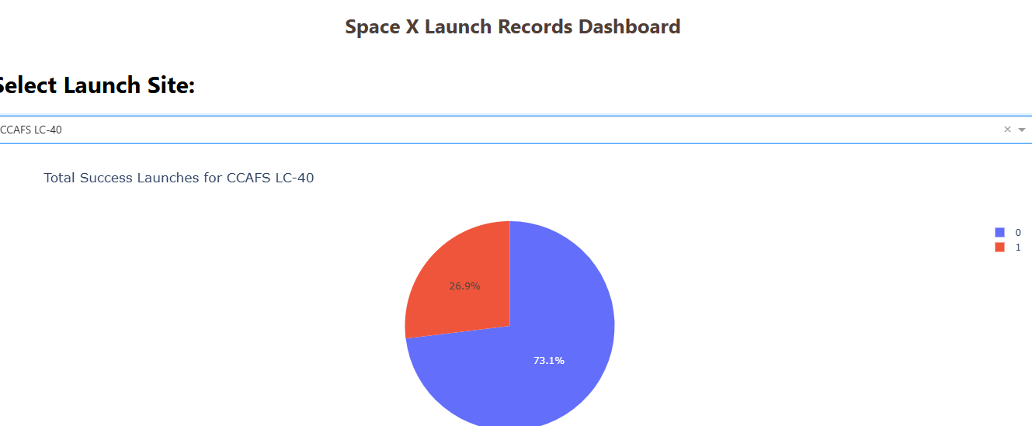
Plotly Dashboard

Slide 39
Predictive Analysis (Classification)

Slide 40
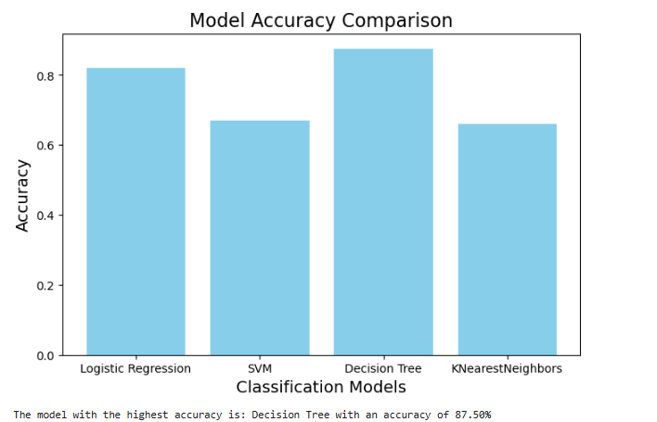
Classification Accuracy

Slide 41
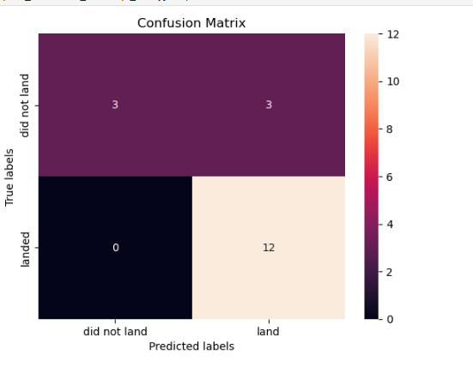
Confusion Matrix of Decision Tree
The confusion matrix reveals that the model has an accuracy of 83%, with perfect recall (100%) for Class 1, meaning it correctly identifies all instances of Class 1. However, it has a precision of 80%, indicating some false positives. Overall, the model performs well, correctly predicting the majority of cases.

Slide 42

Conclusions
The success rate of SpaceX launches has shown a steady improvement, peaking in 2019 with a success rate exceeding 85%.
Location-based factors such as proximity to coastlines, railways, and highways influence launch success rates.
The classification models show promising accuracy, with some models achieving over 80% accuracy, indicating robust predictive capabilities for launch success.
The analysis suggests potential improvements in future launch strategies, particularly in site selection and payload management.

Slide 43


